Slide 1


Discard Stage Survival Guide
Navigating Narcissistic Relationship Withdrawal with Strength and Self-Compassion

Slide 2

The Discard Phase Reflects Their Inability, Not Your Worth
Phase 01
The discard phase occurs when a narcissist suddenly withdraws affection, attention, or the relationship itself. This behavior is a pattern rooted in their inability to maintain healthy relationships, not a reflection of your value.
Understanding The Discard
Sudden emotional withdrawal without clear explanation
Designed to create confusion and self-doubt
Part of a larger cycle of idealization and devaluation
Reflects the narcissist's emotional limitations, not your shortcomings
Understanding this pattern is the first step toward healing

Slide 3

Warning Signs
Seven Behaviors That Signal Narcissistic Discard
Silent Treatment
Cruel Dismissiveness
Unfair Comparisons
Days or weeks of complete communication shutdown designed to punish.
Hurtful comments that minimize your feelings and reality.
Comparing you negatively to others to induce insecurity.
Threats of Abandonment
Emotional Invisibility
Withholding Affection
Repeatedly threatening to leave the relationship to foster fear.
Acting as if you don't exist or matter in their presence.
Deliberate withdrawal of intimacy and care as a control tactic.
Sudden Coldness
Abrupt shift from warmth to hostility without logical cause.

Slide 4

Protective Strategy
Protect Your Dignity by Avoiding These Reactions
01
&
Don't Chase or Beg
Excessive calling, texting, or pleading reinforces their power and diminishes your standing.
02
Don't Blame Yourself
Their behavior is a reflection of their internal state, not your inadequacy or failure.
03
Don't Try to "Fix" Them
You cannot change or heal someone who refuses to acknowledge the problem exists.
04
Don't Isolate Completely
While space is good, total withdrawal from all support systems increases your vulnerability.
05
Don't Make Major Decisions
Wait until emotional stability returns before making life-altering choices like moving or quitting jobs.

Slide 5

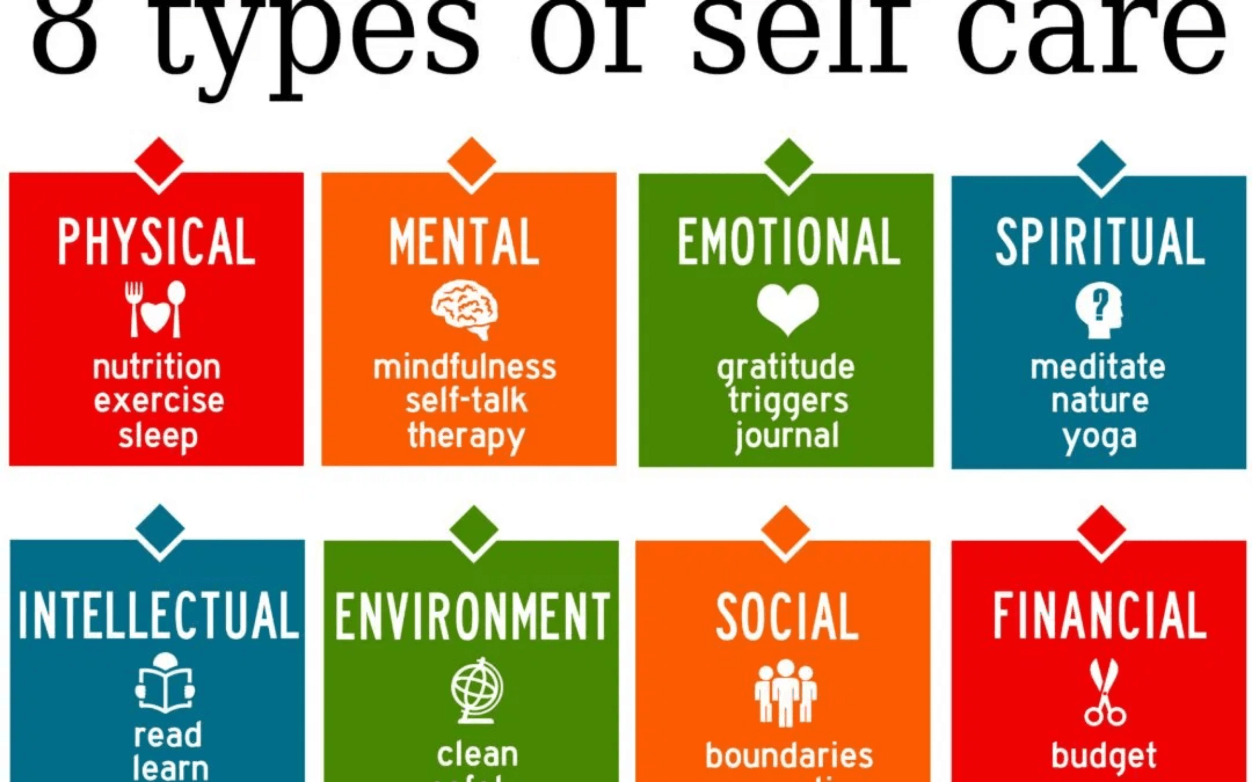
Immediate Strategy
Stabilize Your Well-Being Through Basic Self-Care
During the discard phase, your nervous system is under extreme stress. Returning to fundamental self-care routines helps regulate your body and mind.
Maintain Daily Routine:
Structure provides stability when emotions feel chaotic.
Nutritious Meals:
Regular eating supports physical and mental health.
Adequate Sleep:
Rest is essential for emotional regulation and healing.
Physical Movement:
Exercise releases stress and improves mood.
Breathing & Meditation:
Calms the nervous system and reduces anxiety.

Slide 6

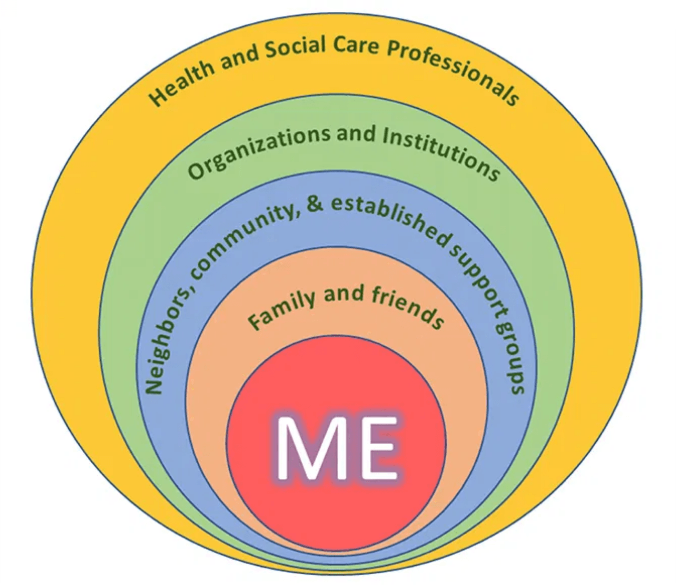




Immediate Strategy
Reach Out for Support
Isolation is one of the narcissist's most effective tools. Breaking that isolation by reaching out to trusted people is a powerful act of self-protection and recovery.
Trusted Friends or Family
Share your experience with safe people who believe you.
Support Groups
Connect with others who understand narcissistic abuse.
Professional Therapy
Seek guidance from a therapist familiar with trauma.
Crisis Hotlines
Available 24/7 when you need immediate support.

Slide 7


Emotional Coping Techniques
Ground Yourself & Regulate
Grounding Exercises
5-4-3-2-1 Technique:
Name things you see, touch, hear, smell, and taste to anchor in the present.
Box Breathing:
Inhale, hold, exhale, and hold for 4 counts each to calm the nervous system.
Progressive Muscle Relaxation:
Systematically tense and release muscle groups to reduce physical stress.
Cognitive Strategies
Shift Perspective:
Remind yourself "This is about them, not me."
Self-Compassion:
Challenge negative self-talk with kindness.
Focus on Control:
Direct energy only toward what you can change.

Slide 8

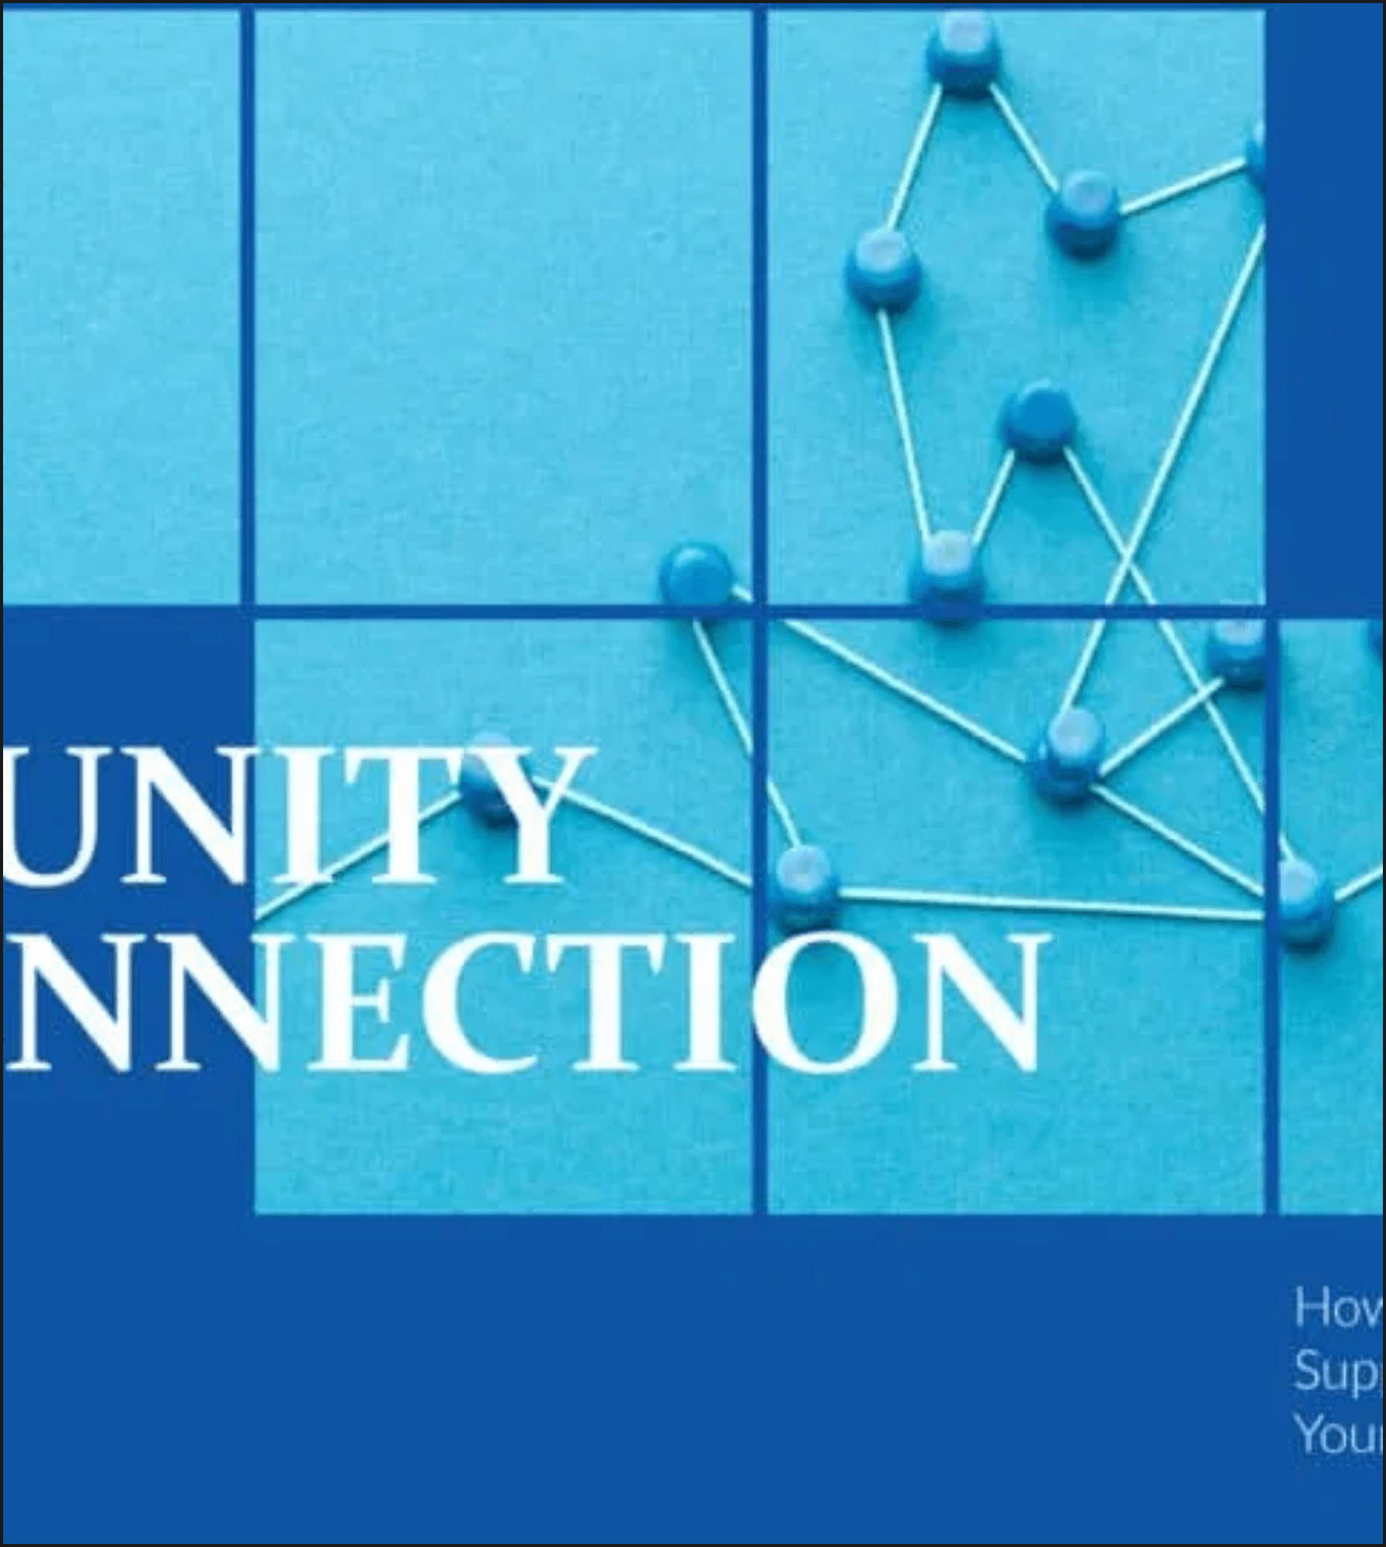
Building a Strong Support Network
Five Steps to Create a Safety Net
01
Identify Safe People
Recognize who in your life is trustworthy, empathetic, and capable of providing non-judgmental support.
02
Educate Trusted Friends
Help them understand the dynamics of narcissistic abuse so they can support you effectively.
03
Join Online Communities
Find validation and shared experiences with others who have walked a similar path.
04
Professional Counseling
Engage with trauma-informed therapists who specialize in narcissistic abuse recovery.
05
Emergency Contact List
Keep crisis resources and trusted contacts readily available for moments of acute distress.

Slide 9

Develop Exit Strategy
Plan for safe separation if you're still in the relationship, prioritizing your physical and emotional safety.
Phase 03
Build Financial Independence
Long-Term Recovery Planning
Secure your economic stability and autonomy to ensure you are never dependent on an abuser.
Strengthen Other Relationships
Rebuild connections with friends and family that may have been neglected or sabotaged.
Recovery from narcissistic abuse is not just about surviving the discard—it's about rebuilding your life with intention, strength, and renewed self-worth.
Focus on Personal Goals
Reconnect with your interests, dreams, and identity that existed before the relationship.
Trauma-Informed Therapy
Address deep emotional wounds and patterns with specialized professional support.

Slide 10

You Are Not Alone
Immediate Help Is Available
National Domestic Violence Hotline
Crisis Text Line
1-800-799-7233
Text HOME to 741741
Confidential support 24/7
Free, 24/7 crisis counseling
SAMHSA National Helpline
Suicide & Crisis Lifeline
1-800-662-4357
988
Treatment referral and information
Call or text for immediate support
If you are in immediate physical danger, please contact Emergency Services (911) or your local authorities immediately.

Slide 11


Core Truths to Remember
Your Worth Is Inherent & Unchangeable
I.
You are not responsible for their behavior.
Their choices reflect their character, not yours.
II.
The discard reveals their limitations.
It is about their inability to maintain healthy relationships.
III.
Your worth is inherent.
Their treatment of you does not define your value as a person.
IV.
Recovery is possible.
With time, patience, and support, healing happens.
V.
You deserve love, respect, and kindness.
This is not negotiable or conditional.

Slide 12

Conclusion
From Survival to Healing
Next Steps
Save crisis resources in your phone
Reach out to one trusted person today
The discard phase is painful, but it can also be the beginning of profound personal growth and freedom. You have the strength to move through this and emerge stronger. Your recovery is not only possible—it's already beginning.
Consider scheduling a consultation
Be patient and compassionate with yourself
*This guide is for educational purposes. If you're in immediate danger, contact emergency services or domestic violence resources.*

